Slide 1
Market Research
PTSD Detection Device
sdmay25-13

Slide 2
Project Overview
America’s VetDogs provides enhanced mobility and renewed independence to veterans, active-duty service members, and first responders with disabilities, allowing them to live with pride and self-reliance once again. While the service dogs are trained to support their owners when they exhibit PTSD symptoms visibly or audibly, the ideal situation is to stop the episode before it happens. America’s VetDogs in partnership with BAE Systems is seeking to develop a device that monitors a spike in an individual’s heart rate and blood pressure before a PTSD episode begin

Slide 3
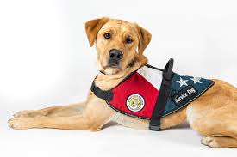
Problem statement
Develop a device that monitors a spike in an individual’s heart rate and blood pressure before a PTSD episode begins. The device should alert the service dog so it can in-turn provide the veteran with comfort. Device must be concealed within the service dog vest.

Slide 4
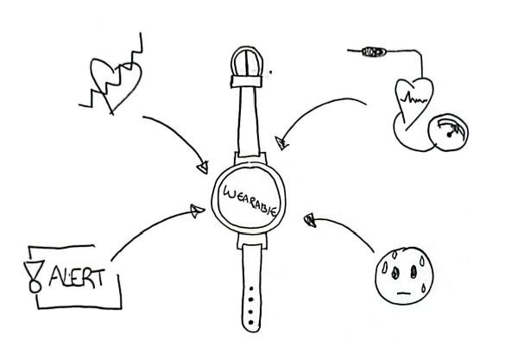
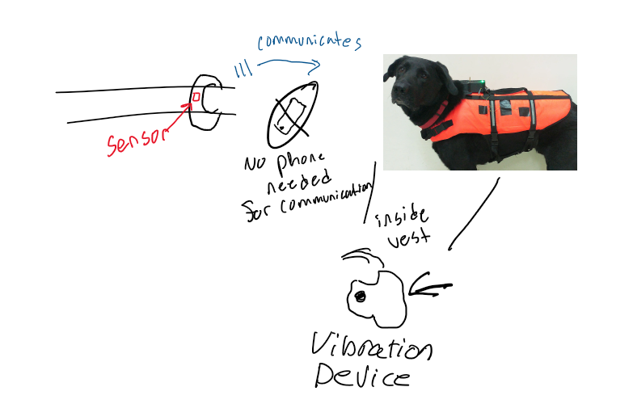
Related products
We Found three related products.
Canine Alert Collar
EDA Sensor (FitBit)
BGU Research Haptic Vibration Commands

Slide 5
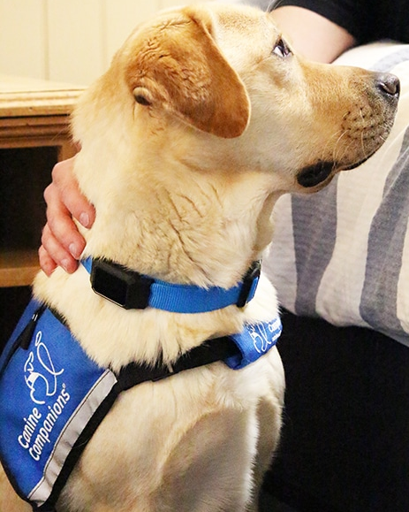
CanineAlert Collar
This product monitors the user’s heart rate in order to detect PTSD episodes and alert a service dog through a vibrating collar.
An advantage to this product is that it collects biometric data and not motion and has specific vibrations that a dog can be trained by.
A disadvantage of this product is that it using a collar which is seen to be possibly inhumane.

Slide 6
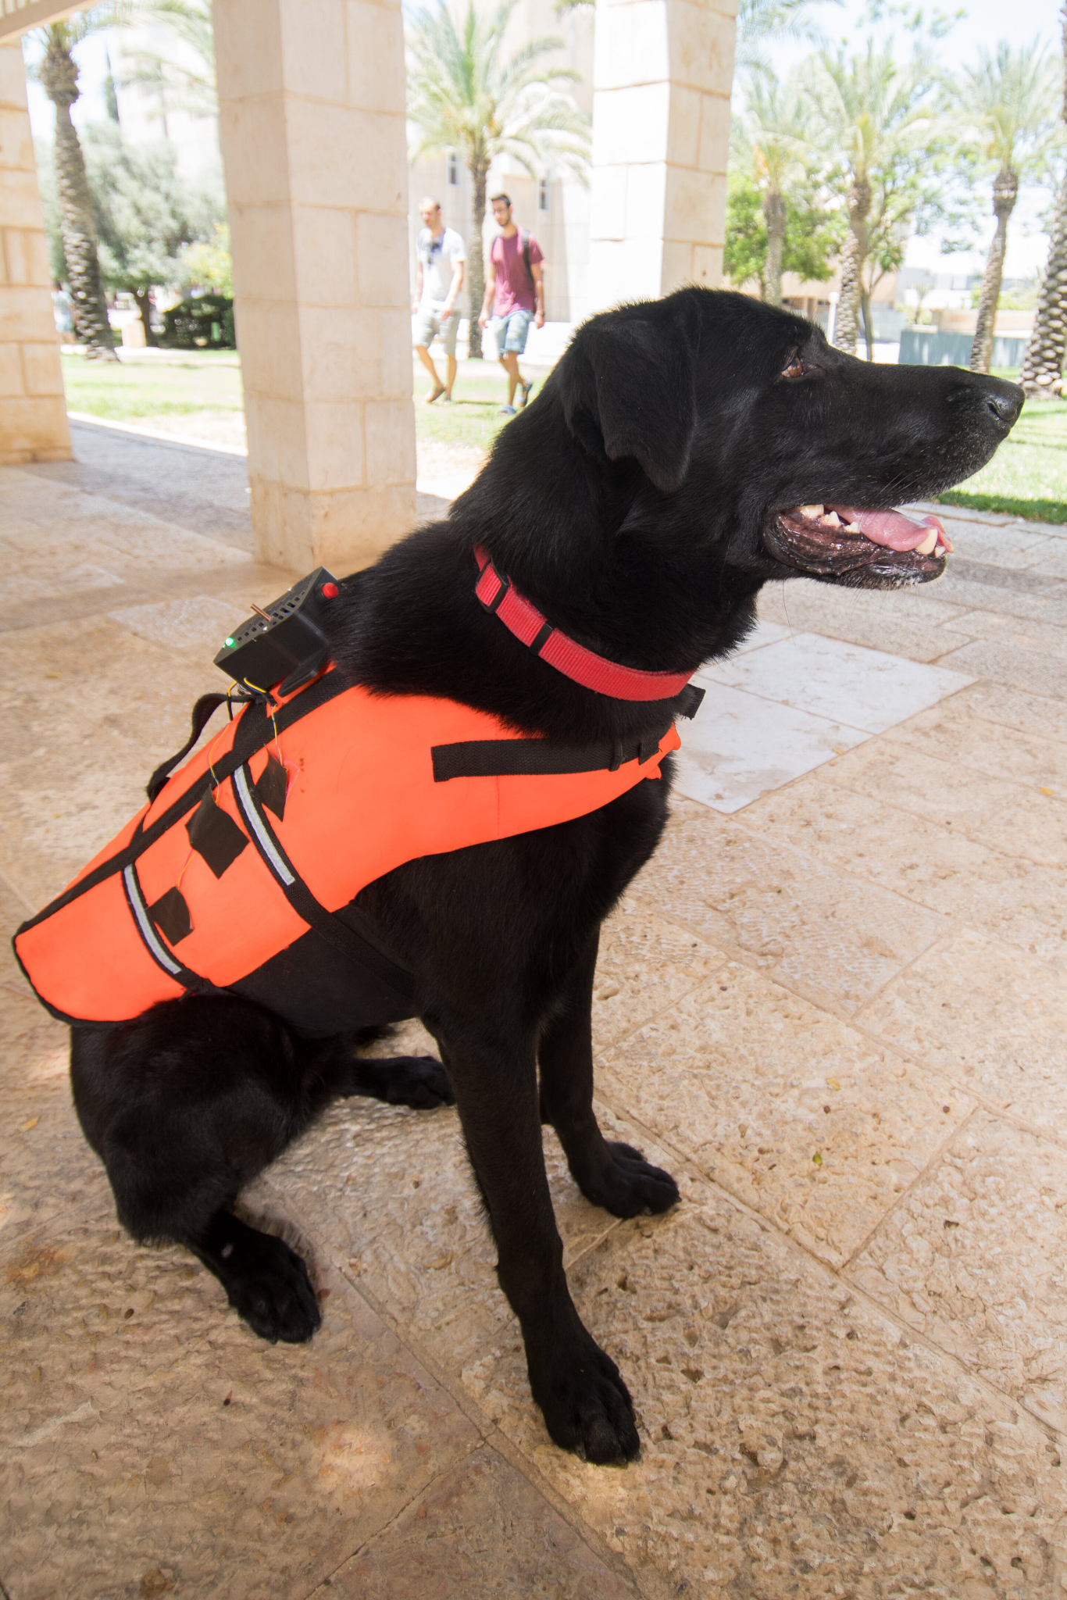
BGU Research Haptic Vibration Commands
This product uses an app to send command signals to a dog using small motors to cause vibrations in the dog vest.
An advantage to this product is that it provinces a vest and allows for customizable commands that can be used to train a dog for various actions.
A disadvantage of this product in relation to our problem statement is that this product does not implement the ability to trigger vibrations based on biometric data.

Slide 7
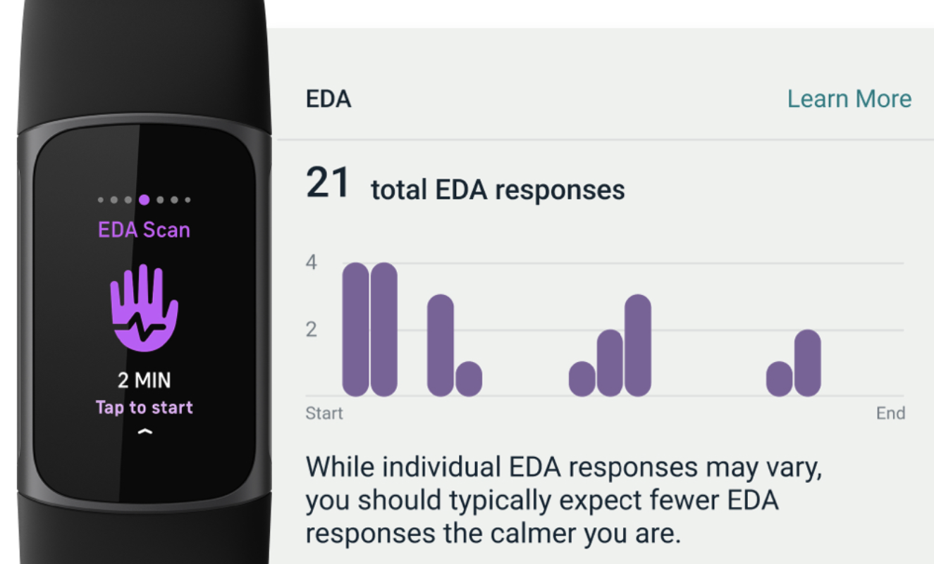
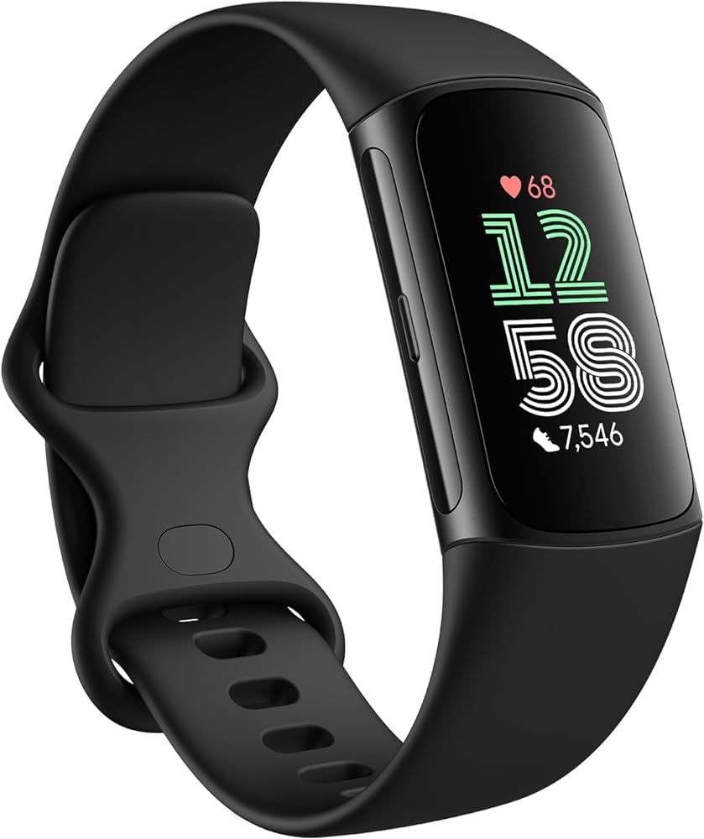
EDA Sensor
This part of the fitbit measures the variances of electrical signals through conductance when sweat is produced on the skin.
Advantages to this product are that is gives an additional way to measure stress besides heart rat. Provides redundancy in detection of stress.
Disadvantages of this product is that this device only reflects intensity. Which could result in false alarms.

Slide 8
Market Gap
-Need for a product that is specified for a service dogs vest
- Communication between device on users wrist and in service dog vest. (Bluetooth or radio)
- wearability of the device
-Accurate sensor that sends signals pre PTSD episode. .

Slide 9
Ideas from project research
Create a device that can send small vibrations and be concealed in the service dog vest, much like the haptic dog vest.
Monitor heart rate of the user in a way similar to CanineAlert Collar.

Slide 10
Conclusion
In conclusion our basis of design is different that current available products based on constraints given from the user.
EX. Not in collar, Humane interaction with service dog.

